Slide 1
California Counties Analysis
File created on: 5/11/2023 7:45:44 PM

Slide 2
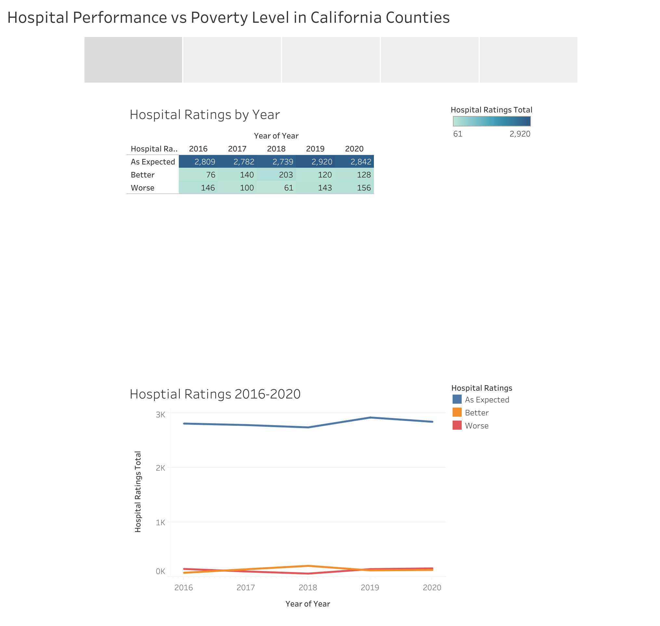

Slide 3
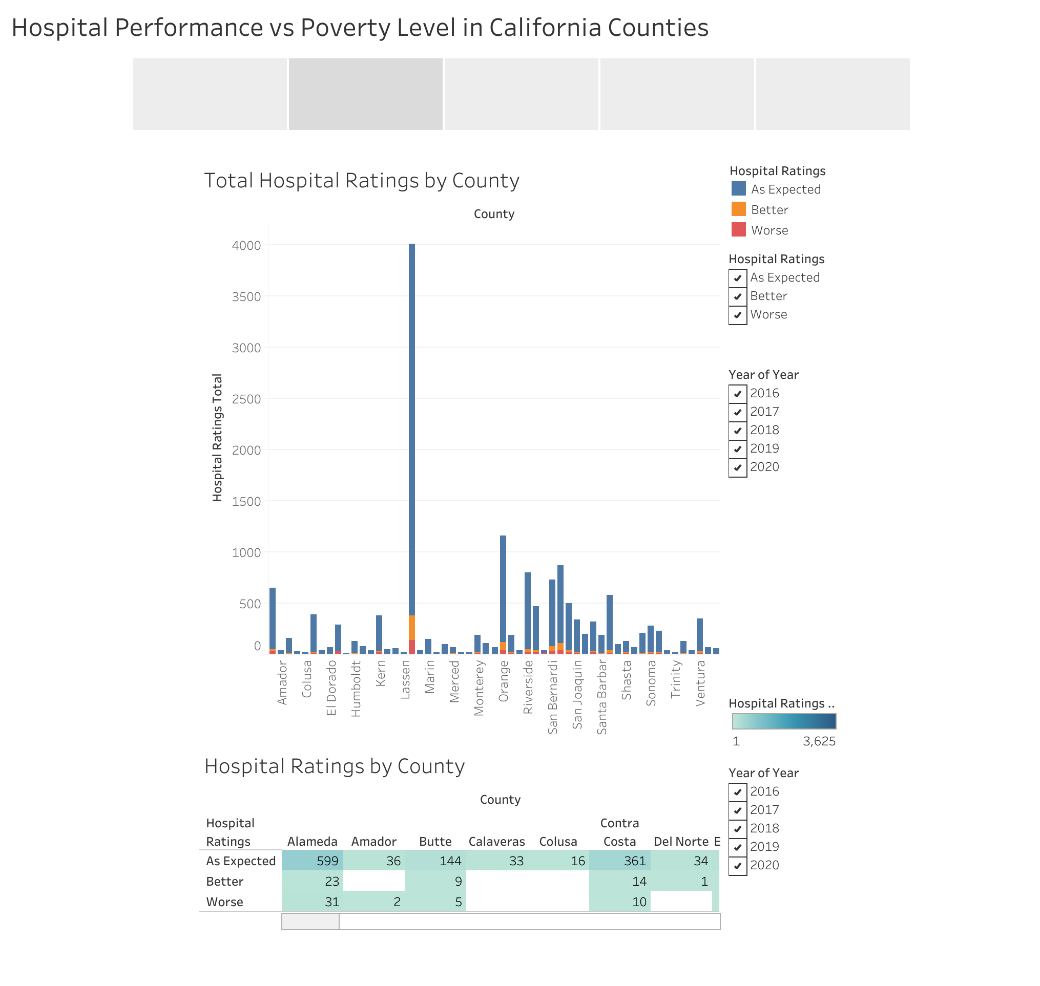

Slide 4
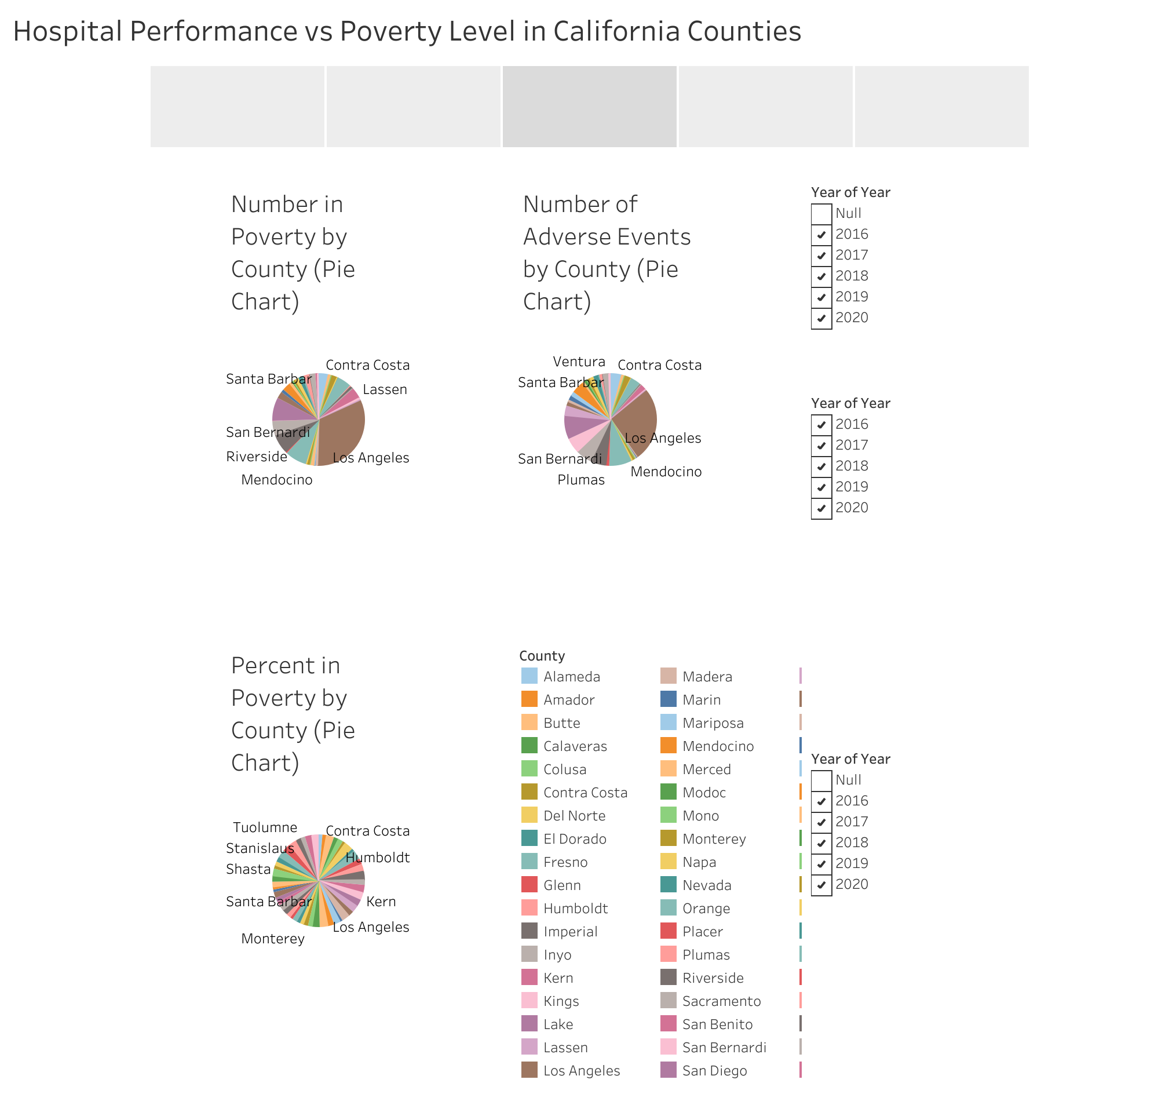

Slide 5
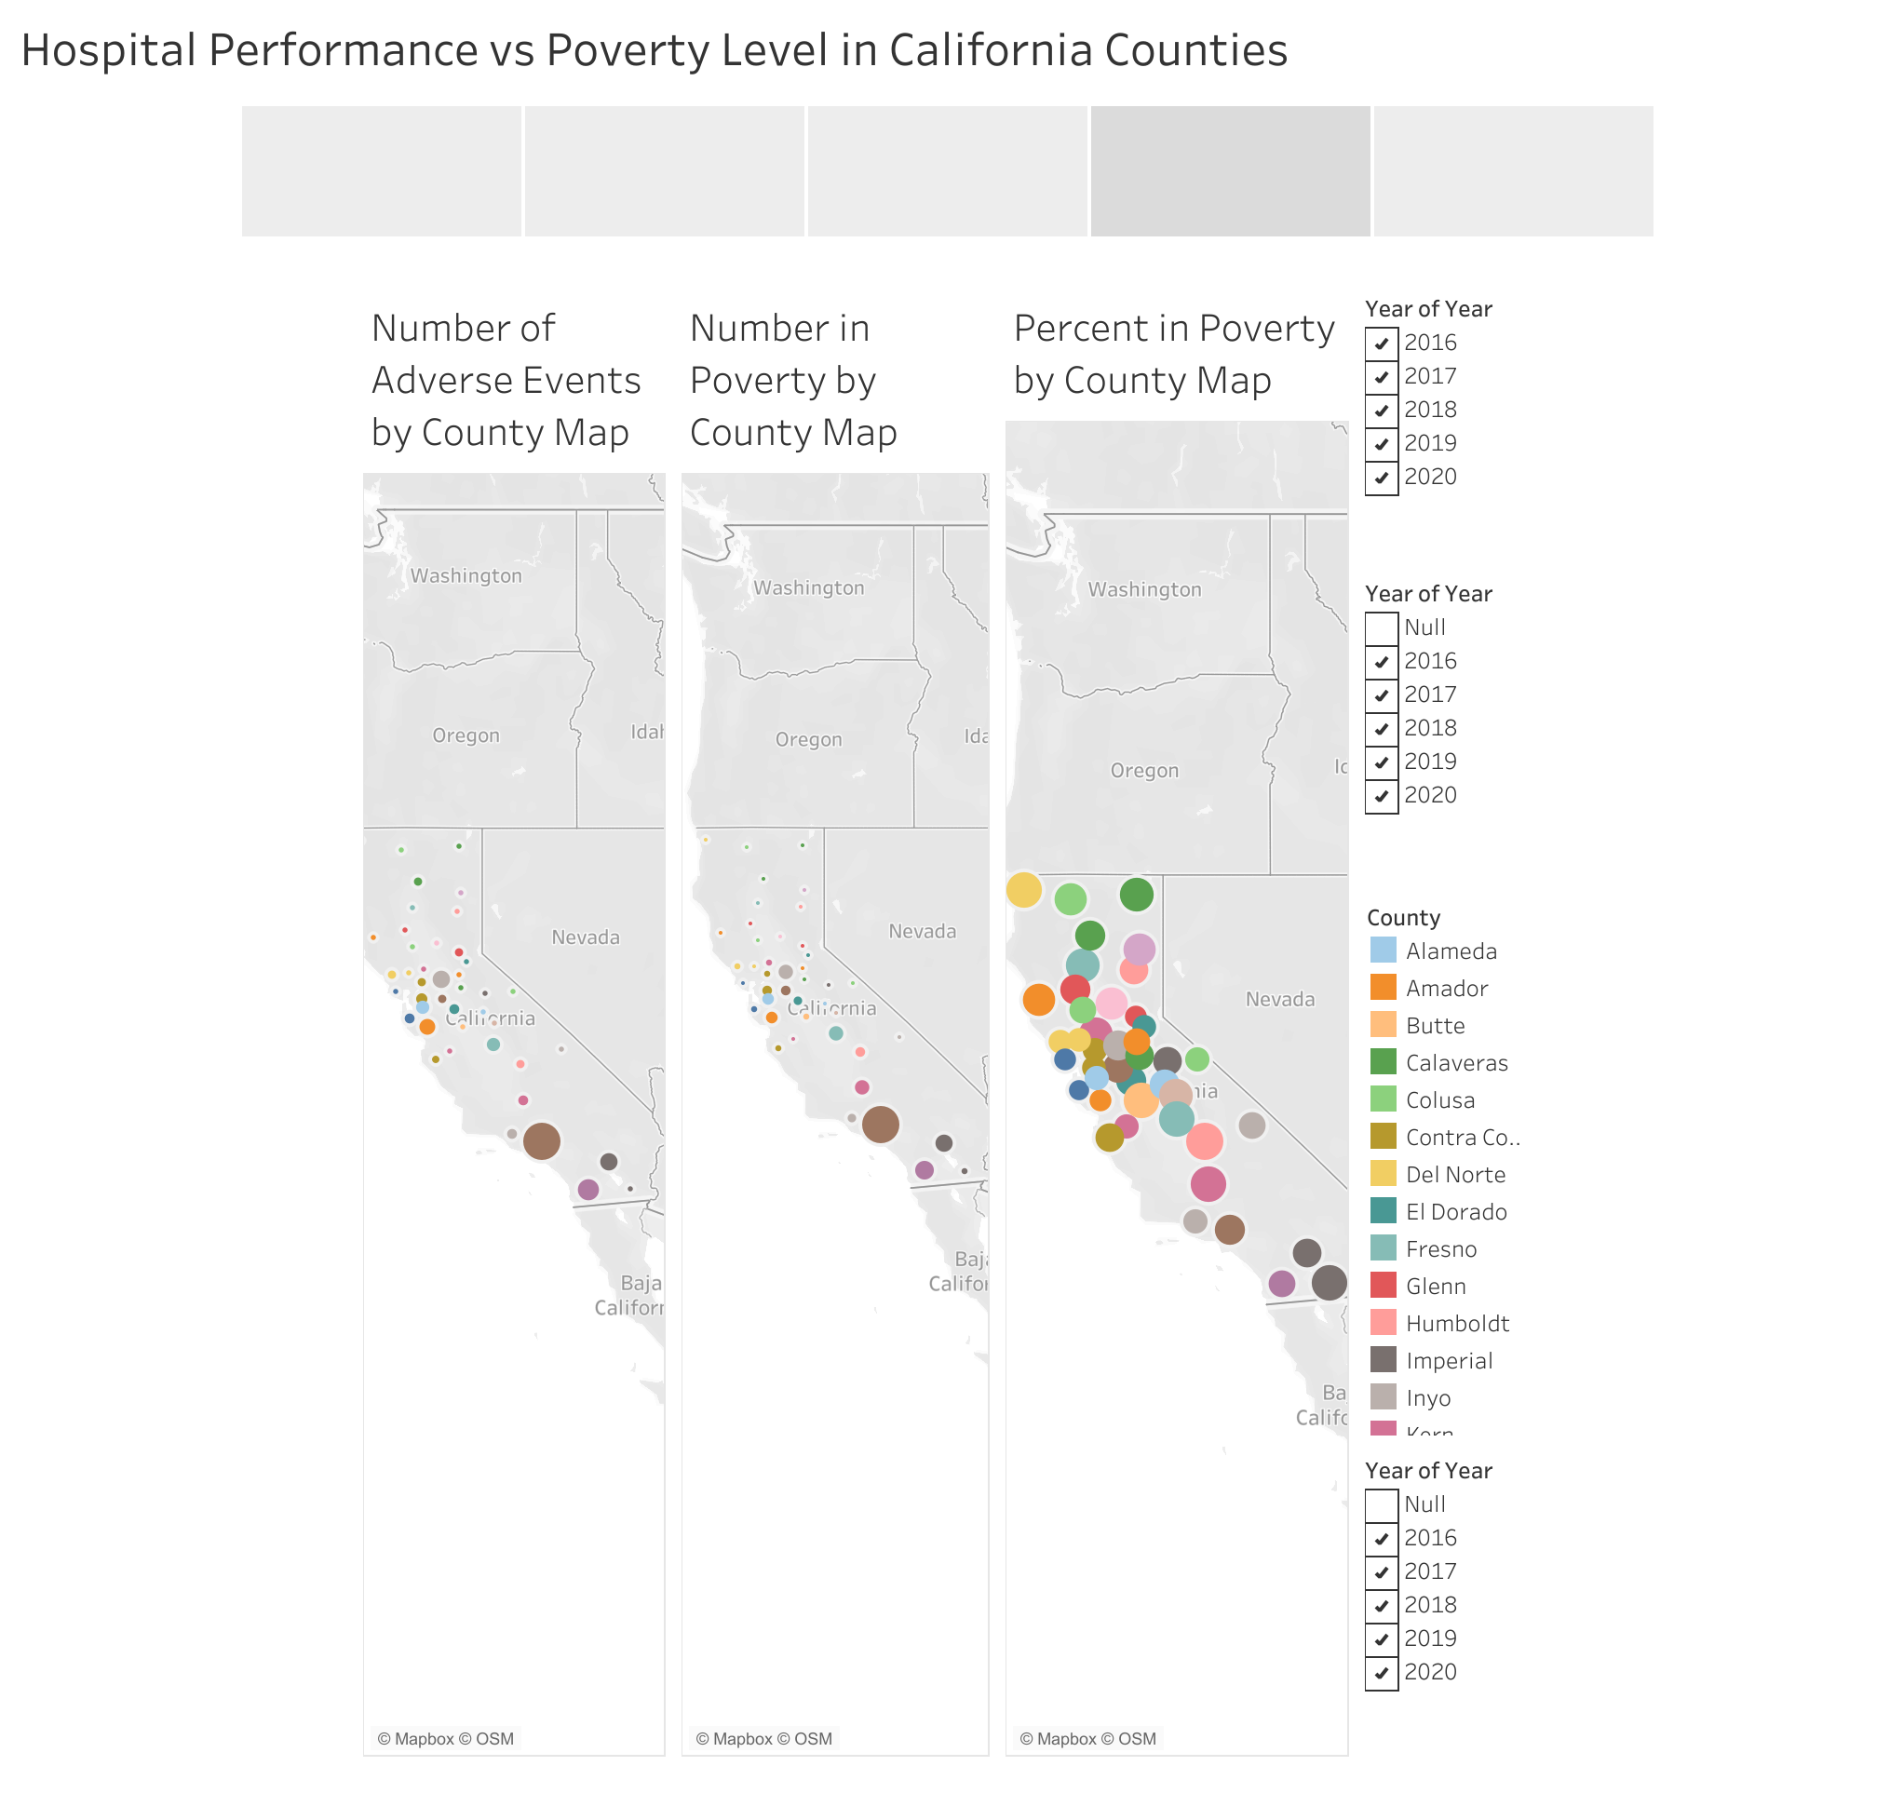

Slide 6
